Slide 1
STEM Buddies Beyond the Classroom
STEM FELLOW-Edelsa Chalanczuk
3rd Grade Math Teacher at Winbourne Elementary
STEM Fellow 19-20

Slide 2
Why STEM in our classrooms?
Today’s and tomorrow’s STEM workforce in Louisiana needs it.
Louisiana’s College Readiness Benchmark Percentages by
race/ethnicity indicate that our Black students scored:
There is a STEM demographic Gap that can and has to be met.
The STEM belief gap is meant to be broken by our students.
Math | Science | STEM
9% | 10% | 2%

Slide 3
Winbourne Data that supports our WHY?
Science and Math Benchmark Grades- 3rd Grade Only
Classroom | Beginning of the Year | Middle of the Year | End of the Year
Kindergarten Math | 0% | 100%
3rd Grade Math | 6% | 56.6%
3rd Grade Science | 36% | 15%

Slide 4
Project- Building a Community for STEM at Winbourne Elementary
The Plan:
Kindergarten STEM Club Season- 9 weeks spread apart between the Fall and Spring Semester.
Use Kindergarten students as our source of data.
Use the Louisiana Science Standards for Kindergarten to plan STEM based lessons.
Track and gather Kindergarten attendance data prior to the start of STEM Club Season and at the end of it.
The “Tweaking” of the plan:
Stem Buddy Club Season- 6 weeks during the Spring Semester.
Use one Kindergarten and one 3rd grade class as the source of data.
Use the Louisiana Science Standards for kindergarten and 3rd grade to plan STEM based lessons.
Track and gather 3rd grade data for Science and Math based on EBR’s Benchmark assessments for the beginning, middle, and end of the year.
STEM Buddy Project Extravaganza!

Slide 5
Establishing Computational Thinking and Engineering Design Process:
Decomposition
Brainstorm Solutions
Identifying the problem
Research the problem

Slide 6
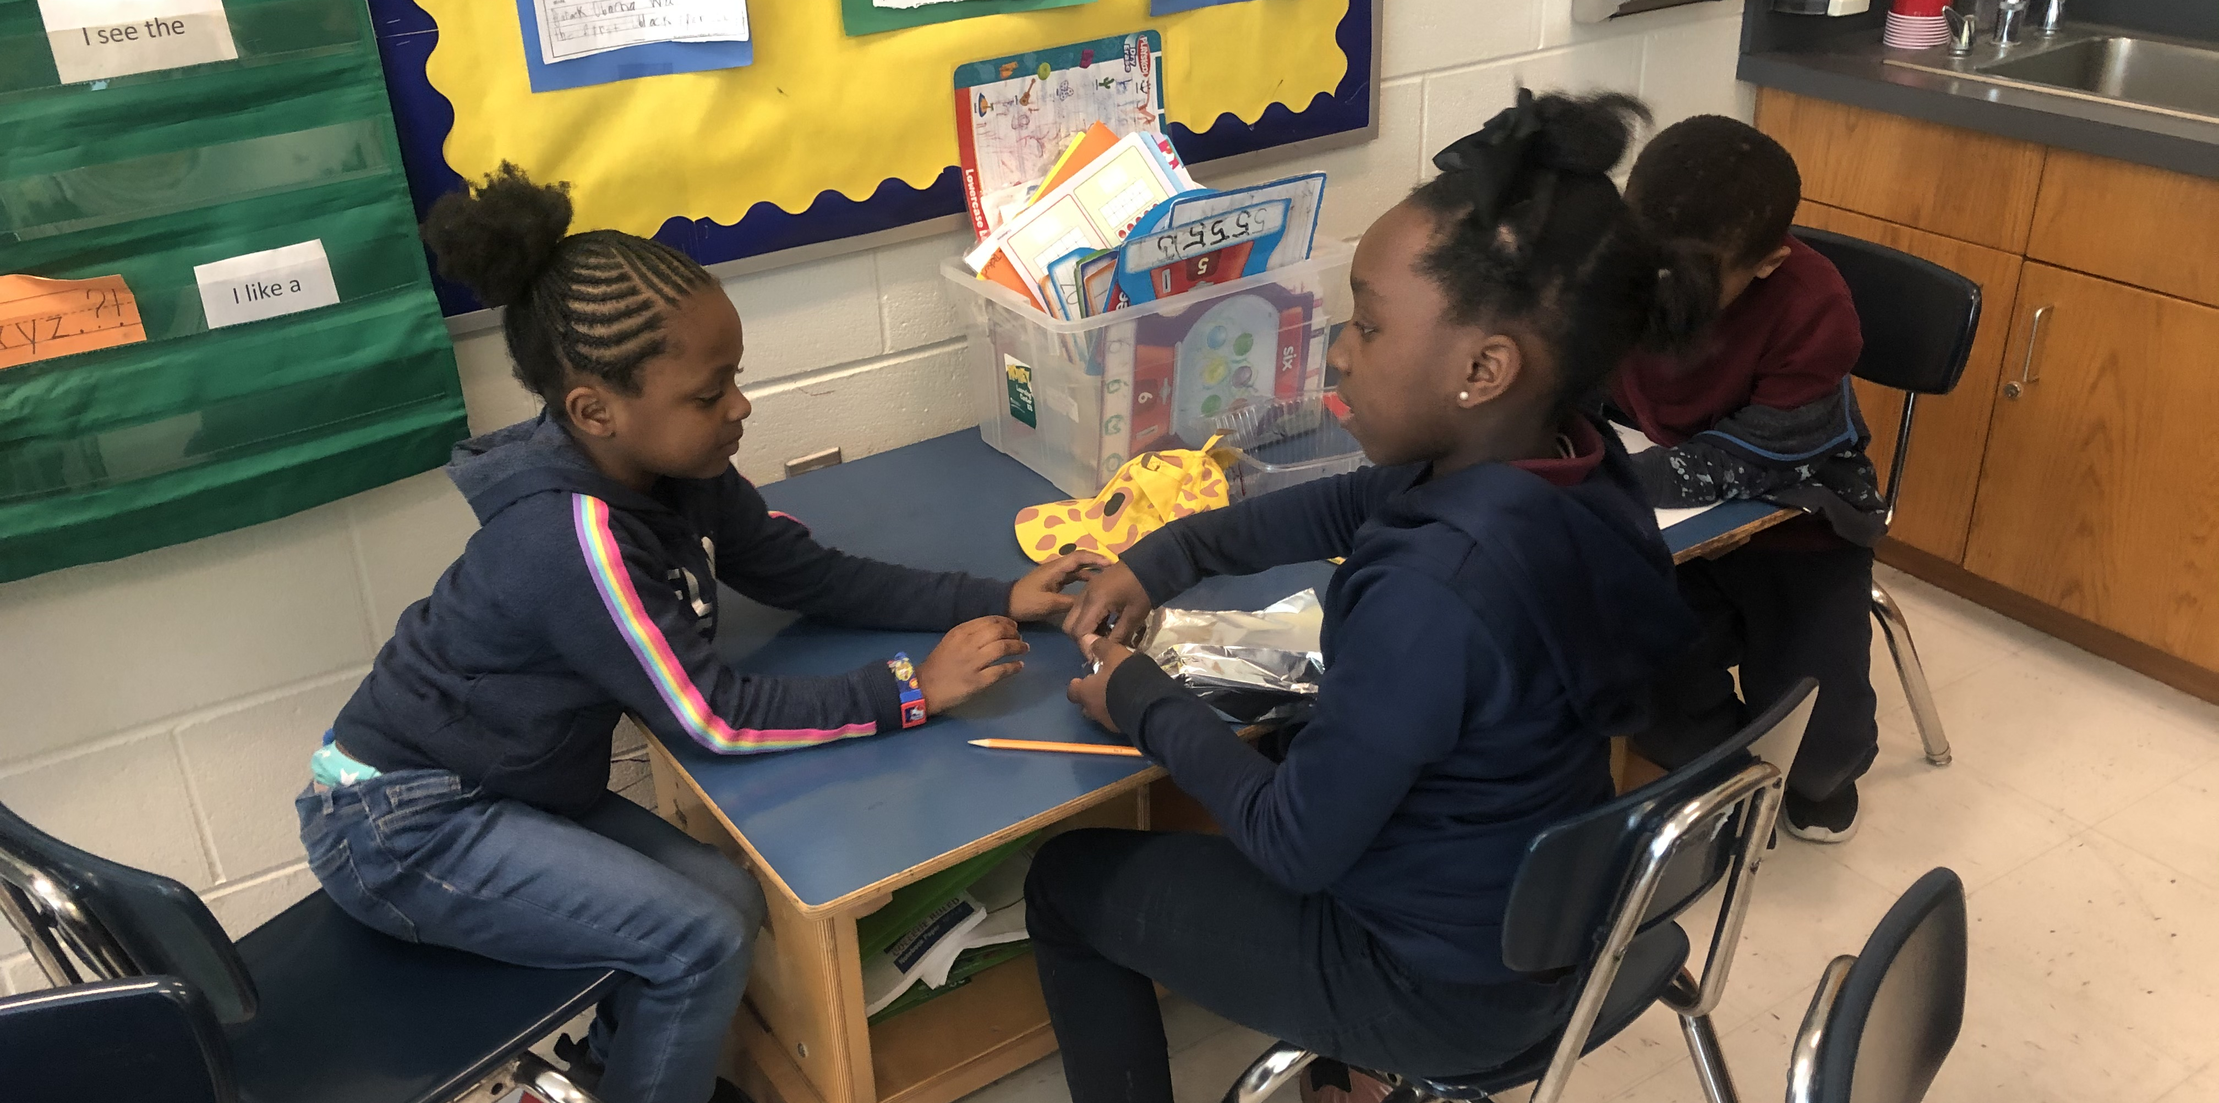
STEM Partners working together:
Algorithm Design
Choose a Solution
Create and Develop a Prototype

Slide 7
STEM Partners testing their projects:
Abstraction and Pattern Recognition
Test and Evaluate the prototype
Improve and Redesign

Slide 8
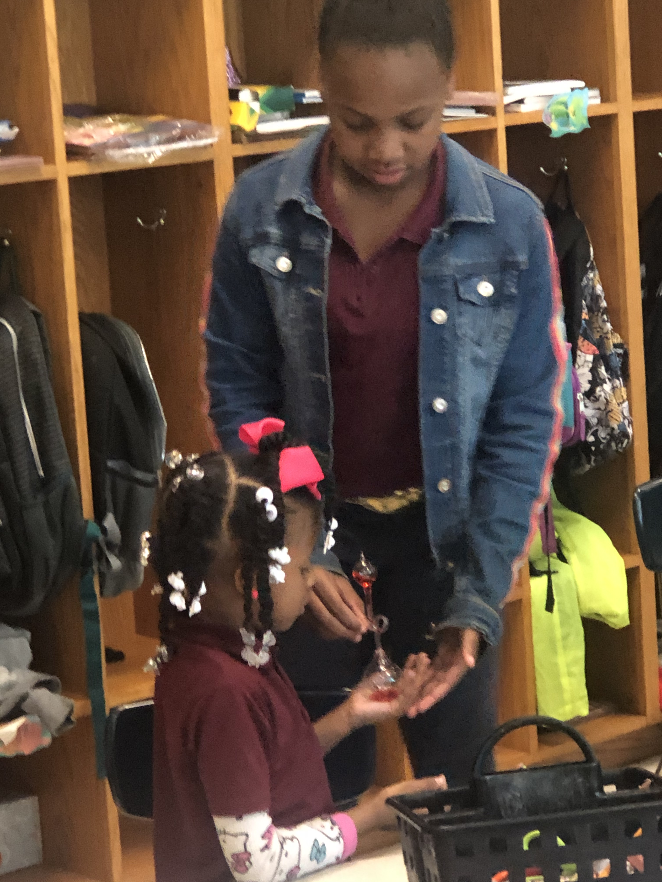
STEM Club Season Calendar:
Friday, February 28th – STEM Partner Introduction Day!
Friday, March 6th- STEM Project- Survival Forces 1
Friday, March 13th- STEM Project- Small Groups collaborations
Friday, March 20th- STEM Project- Small Group Collaborations
Friday, March 27th- STEM Project- Small Groups Collaborations
Friday, April 3rd – Preparing Final STEM Project
Thursday, April 9th- STEM Buddy Project Extravaganza

Slide 9
Standard Based STEM Lessons:
Kindergarten
Earth and Human Activity
1. Surviving Storms at Sea
2. Sprout House
3. Walking Water Rainbow
Forces and Interactions
Conversation Hearts Catapult- Simple Machines Set by LEGO
Straw Bridges
3. WeDO 2.0
3rd Grade
- Inheritance and Variation of Traits
1. NICERC- Life Cycle Lesson
Fossils
1. NICERC- Fraction Lesson

Slide 10
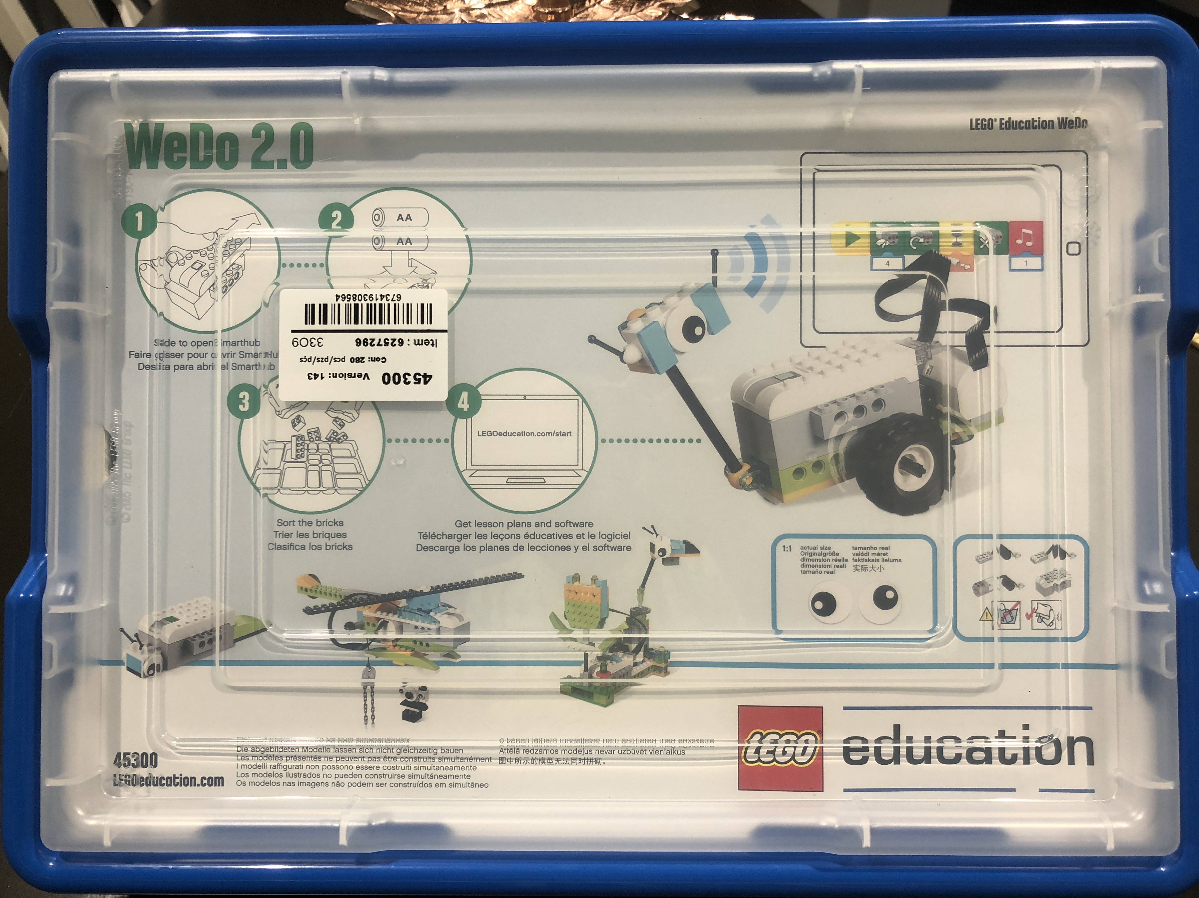
STEM Materials Available:
WeDO 2.0 LEGO Kit
Simple Machines Set by LEGO
Simple and Powered Machines Set by LEGO Education
Extra LEGO Supplies
STEM Kit 1 and 2 – Assorted materials

Slide 11
STEM Material Checkout Procedures:
Procedures:
1. Teacher must sign the STEM Sign Out/Sign In Binder.
2. Always keep track of all materials.
Recommendations:
- All STEM materials will be available for checkout through our Technology Coordinator.
Materials are available for signing out 1 to 2 weeks at a time.

Slide 12
Extra STEM Resources Available:
District Pacing Guides
https://docs.google.com/document/d/1L4zwPLlw6QxfvGkdhrJ2BcMpJF6Uk1JsMUn3YCBTceI/edit
NICERC- request form submission
https://nicerc.org/
CODE
https://code.org
LEGO Education- Free STEM Lesson plans
https://education.lego.com/
STEMed Labs
https://www.stemedlabs.org/ilp/?gclid=Cj0KCQjws_r0BRCwARIsAMxfDRh44dyUCCfQn6R5hABe1bKLcLwp6FHvnqv0ruup7AuMlDu6fmL7CesaAnPEEALw_wcB
STEM Finity- HUB for free STEM resources
https://www.stemfinity.com/free-science-resources

Slide 13
Consider the following:
STEM education provides the intrinsic rewards of natural curiosity and search for meaning in all students no matter their academic, emotional, and social background.

