Slide 1
Just Like Me
How to increase students understanding in STEM.
Presented by Jerlisa Robinson

Slide 2
Short Description
The effects that mathematics have on students when it does not relate or interest them. Having a discussion about what teachers have notice about students in Mathematics and what could we do to change that. Giving students the opportunity to create their own learning space that will help them with mathematics and giving students the opportunity to explore and what all is available to the in the STEM field.

Slide 3
Overview/Goals
Understand what helps students learn mathematics.
Find new and innovative ways to make mathematics relate to the students based on their interest.
Help provide new resources to STEM careers and opportunity in the community.
Give students and opportunity to personalize their learning within the classroom.

Slide 4
Topic Areas Addressed
Issues Addressed
Career, Technology and Life Skills
Personalization of Learning
Post Secondary Gap
Belief Gap
Student Engagement

Slide 5
How likely are you to get a question correct that you do not understand?

Slide 6
STEM NIGHT/PROJECTS
The students were to choose a topic that interests them.
RULES Don’t pick one because you think it will be easy.
Talk it over with your parents when you have decided, inform your teacher, and do not ask to change your topic later.

Slide 7
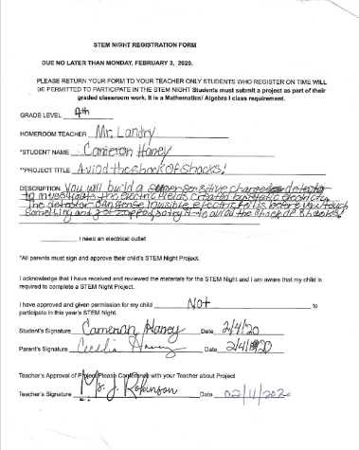
Registration Form
Students were asked to submit a registration form. The form confirmed the following:
STUDENT NAME
PROJECT TITLE
DESCRIPTION
PERMISSION TO PARTICIPATE

Slide 8
Written Report
The written report was a summary of everything that you did to investigate their personal topic. The written report provides others with vital information on what the project is about as well as its effect on your understanding of the topic.
EL: Written Report

Slide 9
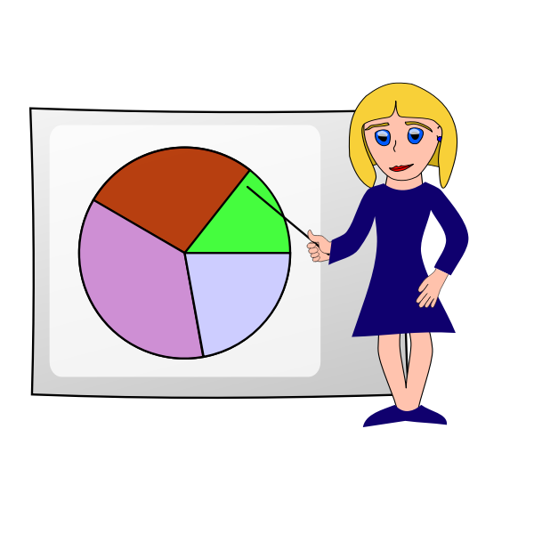
Presentation
The students were instructed to make a presentation about the topic they selected. This gave the students full creativity to make their projects what they vision for their topic.
KL Presentation

Slide 10
Awards
Due to their hard work and creativity. I let outside judges vote on each students presentation to receive an awards. Each class had a first, second, third place winner.

Slide 11
What do you think was the end result of the project?

Slide 12
Topic Areas Addressed
Issues Addressed
Career, Technology and Life Skills
Personalization of Learning
Post Secondary Gap
Belief Gap
Student Engagement

Slide 13
STEM Project resulted in a 95% participation in all my classes.

