Slide 1
Cougar Engravings a Fabrication Lab
Lorie Gaubert
Southeast Middle School
Baton Rouge, LA

Slide 2
Project Goal:
Helping students become invested in their learning for their future
STEM employment is expected to grow about 13% by 2022*
Students exposed to fabrication labs
Score better than 70% of a grade level in math**
Score better than 40% of a grade level in science**
**National Assessment of Educational Progress -Urmila Marak- www.mandlabs.com

Slide 3
Participants at my school:
92% of students are from families that are at or below the Poverty line in Baton Rouge
Many have one or more special needs
Many are three to four years behind in reading and/or math
One class is on level or above in reading and/or math

Slide 4
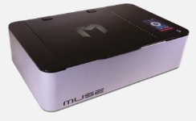
Fabrication Lab Materials
Machine:
Full Spectrum Muse Core Desktop CO2 Laser System (no camera)
Muse Rotary Riser Combo
Cool-Box
Exhaust Fan
Material to engrave/cut:
Cardboard
Cardstock
Colored copy paper
Acrylic-various sizes, shapes
Wood-various sizes, shapes, thickness
Leather
Glass

Slide 5
Students participating in this program will learn:
Application of the design process
Researching problems
Brain storming solutions and possible flaws
Building prototypes
Testing and redesigning solutions
Persistence in solving problems
Working as a team
Respect for others and embracing differences
Learning work past disagreements and find common ground
How to successfully interact with a verity of groups to gain knowledge of financial literacy, work readiness, and entrepreneurship

Slide 6
How a Laser Engraver can add STEM to all classes

Slide 7
Math and Science
Math
Science
Understanding of:
Proportions- increasing for height, width or length will change the other dimensions
Fractions and decimals
Ratio and Percent
Dimension
Estimation
Cost
Supplies needed
Time
Practicality of solutions
Physical Science
Atoms and elements
Newton's Laws
Chemical Formulas
Life Science
Cells and Cell Structure
Human anatomy
Earth Science
Creating 3D maps
Erosion
Rock cycle
Fossils

Slide 8
Social Studies and English/Language Art
Social Studies
ELA
Historical buildings
Maps and map keys
Monuments and statues
Mask of famous people
Shapes of states, symbols, continents
Create symbols to reflect images, themes, moods of books or poems that they have read
Design a character for a story that they create
Identify a problem in a story and create a solution

Slide 9
Business Model and profit split
Business Model
Profit Split
Design and create key chains, ornaments, etc. to sell
Engrave images into tumblers supplied by other students
Design/print business cards for faculty members
One-third will go to a charity voted on by the students
One-third will go to immediate supplies to create other projects
One-third will be saved for large items that will be needed to improve the program over the next few years (air pump, air filter, different focus lens, etc.)

Slide 10
Project process questions
Before the project
What are you willing to do or try out?
Let’s define the best possible outcome and then figure out how to make it happen?
What steps are we/you going to take to get this done?
How long do you think this project will take? What is our/your timeline?
During the project
What were we/you missing?
What is another way to look at this?
After the project
What did you learn?
What were we/you missing?

Slide 11
Evaluation

Slide 12
Measurements of student engagement
Improve student attendance to class/school
A decrease rate of in-school-suspensions among students participating in this program
Increase enrollment in the robotics class, once projects are produced and showcased at the school
A decrease in classroom disciplinary actions
Students will use the communication skills and conflict resolution skills in all classes and activities
Students engaged in this program will have an increase in LEAP and Unit test scores as a result of the above measures

Slide 13
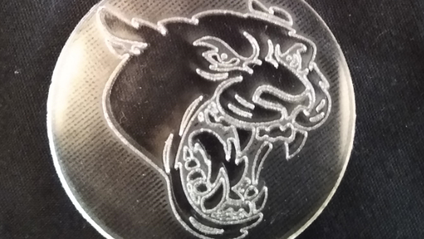
Examples of student projects

Slide 14
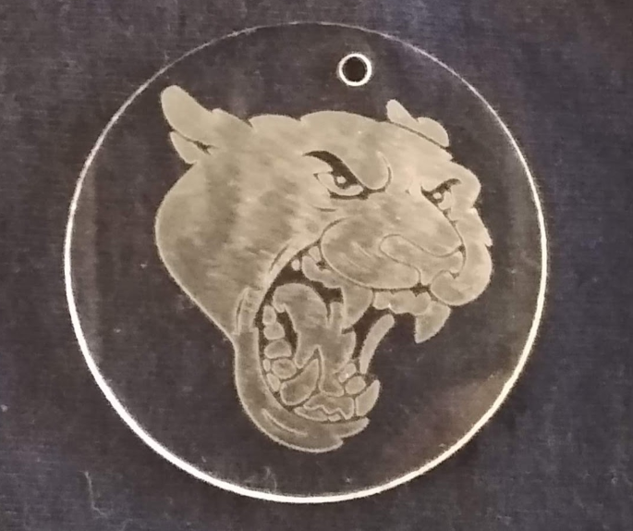
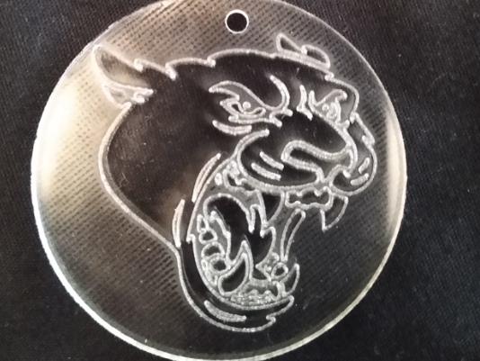
Cougar Mascot Keychains

Slide 15
Alice in Wonderland Clock

Slide 16
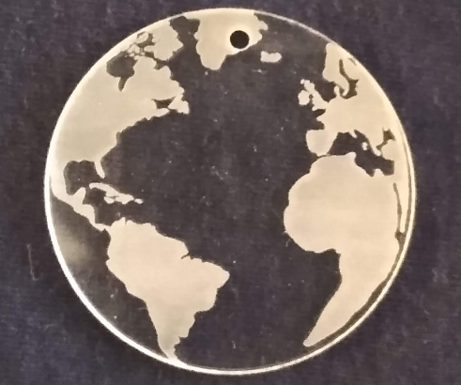
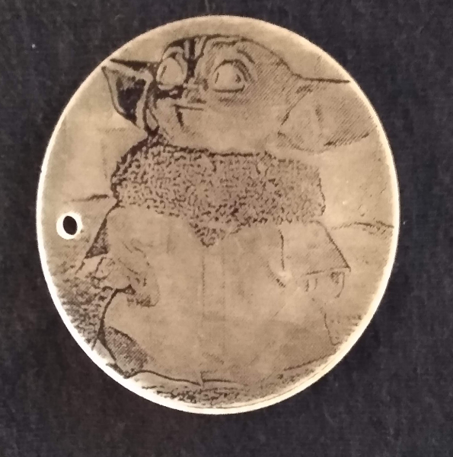
World
Keychain
Baby Yoda

Slide 17
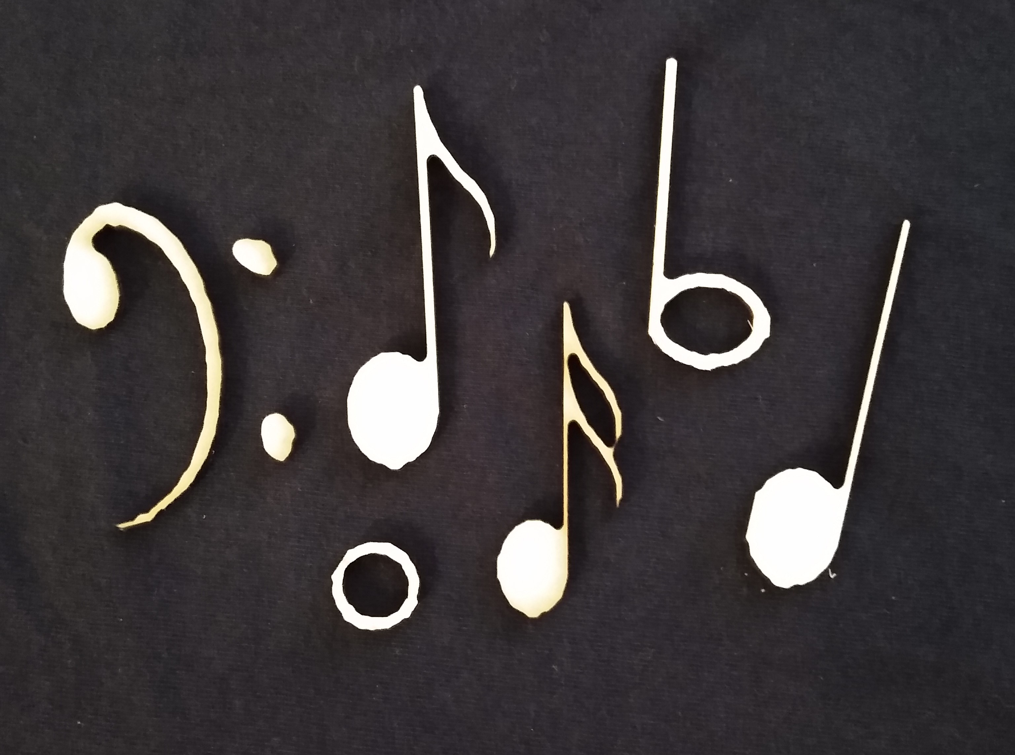
Music notes cut from wood for use by a blind student in music class

Slide 18
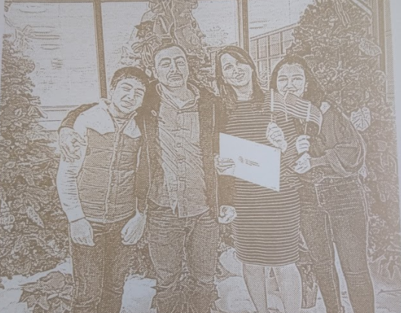
From a color picture

Slide 19
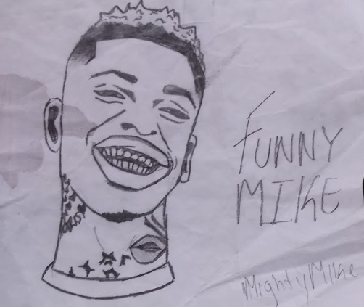
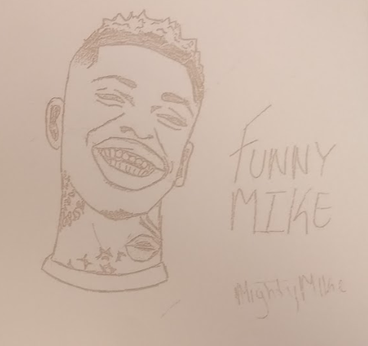
What the student drew
Etched on poster board

Slide 20
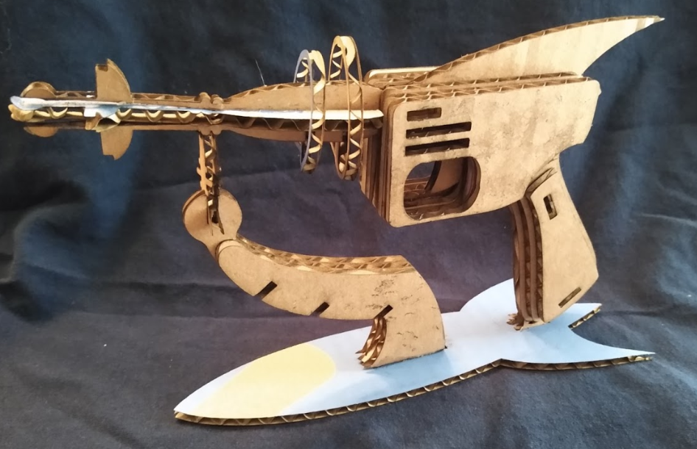
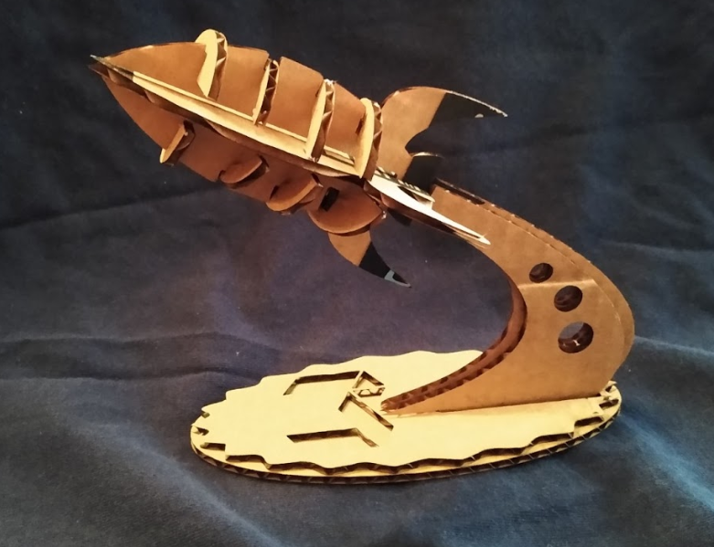
Cardboard Laser Gun
Cardboard Rocket

Slide 21
Alice In Wonderland Clock Video
Ray Gun Video

Slide 22
If anyone has questions
Or needs information,
Please contact me at:
Lgaubert@ebrschools.org

